Slide 1
Geopolymers adsorb methicillin-resistant Staphylococcus aureus cells and secreted proteins
Collin Ganser
4-18-2020

Slide 2
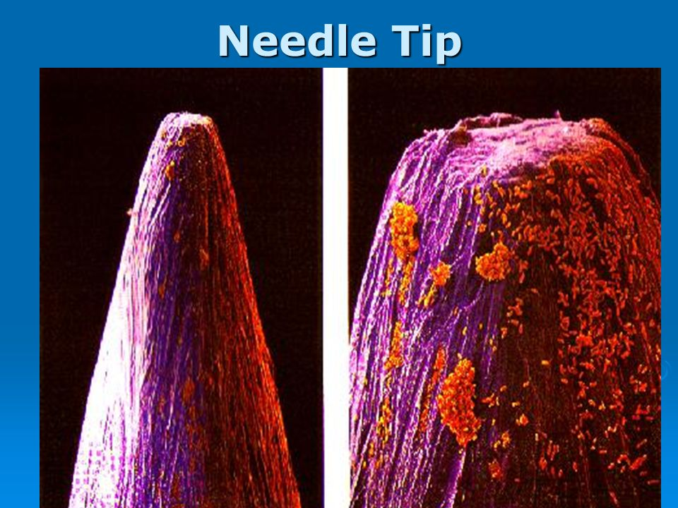
MRSA
Originated from Staphylococcus aureus
Opportunistic pathogen
Antibiotic-resistant “superbug”

Slide 3
MRSA
Antibiotic resistance crisis
Morbidity and mortality
Economic burden

Slide 4
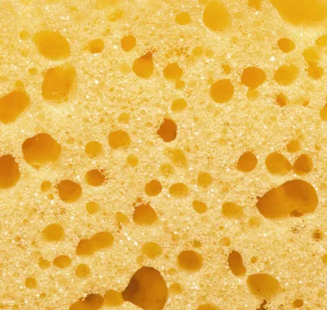
Geopolymers (GPs)
Cells and proteins
Traditionally used in construction and ceramics
Seo lab designed GPs for use as antimicrobial agents
Hypothesized to adsorb materials on pores

Slide 5
Investigation
Question: How effective are geopolymers at adsorbing MRSA secreted proteins?
Hypothesis: mesoGP will adsorb the most MRSA secreted proteins
GPs | Non-coated | Stearic-acid coated
Large pore | MacroGP | SA-macroGP
Small pore | MesoGP | SA-mesoGP

Slide 6
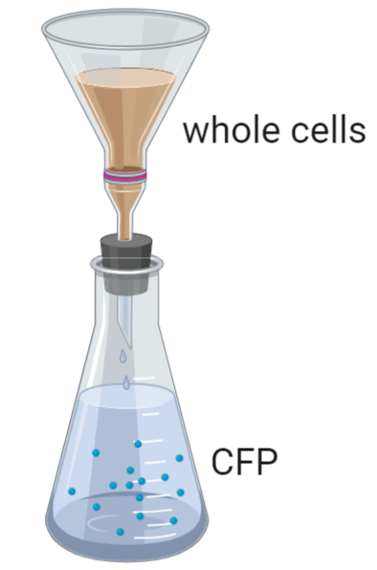
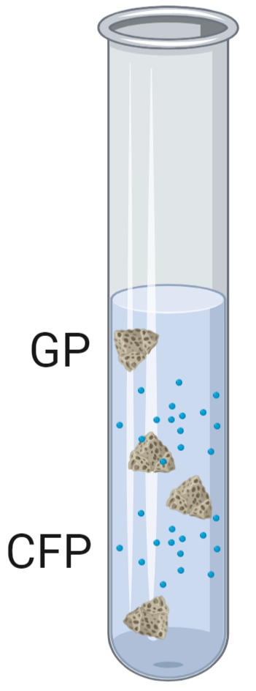
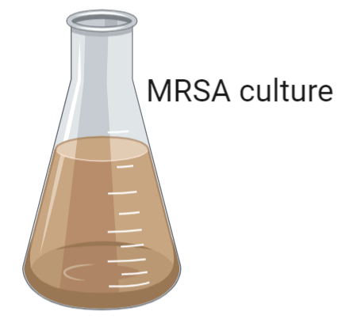
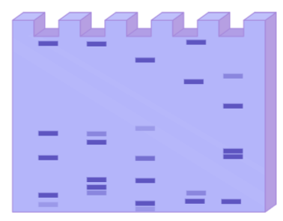
CFP binding methods
SDS-PAGE
CFP = culture filtrate proteins

Slide 7
SA-mesoGPs bind the most CFPs
*, P < 0.05; ***, p < 0.001; student’s t test comparing GPs

Slide 8
Mass spectrometry methods
Analyzed 2 sets of CFP samples
Control CFP
Identified over 100 proteins
Considered proteins present in >50% replicates
Identified bound proteins
Compared control proteins to experimental proteins
CFP incubated with SA-mesoGP

Slide 9
58 distinct proteins were bound by SA-mesoGPs
A
B
C

Slide 10
Conclusions
Geopolymer effectiveness at adsorbing MRSA secreted proteins
SA-mesoGP >> mesoGP > macroGP > SA-macroGP
  Bound proteins identified by mass spectrometry have diverse size, function, and location

Slide 11
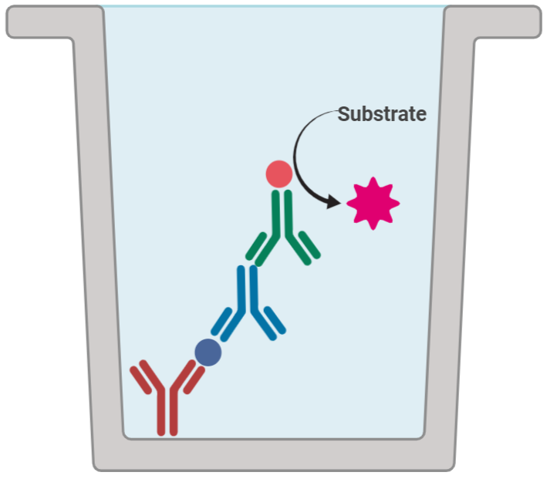

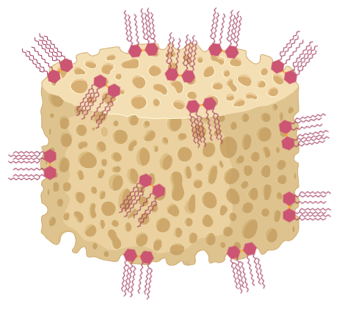
Future directions
Western blot, ELISA, or RT-qPCR with CFP
Hemolysis assays with CFP
Development of GPs with affinity coatings

Slide 12
Acknowledgements
Dr. Shelley E. Haydel
John Popovich
The Haydel Lab
Shaojiang Chen
Dr. Dong-Kyun Seo
Dr. Tim Karr
ASU/NASA Space Grant
School of Life Sciences Undergraduate Research (SOLUR) Program

Slide 13
Thank You!
Questions?

